Slide 1
World Music
Turn your Volume on (not too loud)
Make sure you are in “Slide Show” mode to hear the music and have access to the videos by clicking on the hyperlinks.

Slide 2
Music in Ireland
Dorothea E. Hast
Stanley Scott

Slide 3
Geographical Location
The country Ireland, is located within the continent of Europe.
Where is Ireland?
Click on hyperlink to view the country of Ireland
Zoom out to see where Ireland is in the context of Europe and the world.

Slide 4

Ireland in Pictures
Scroll through slowly
Music: “Toss the Feathers” by the Coors (and Irish Group)

Slide 5
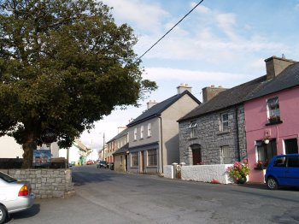

Slide 6
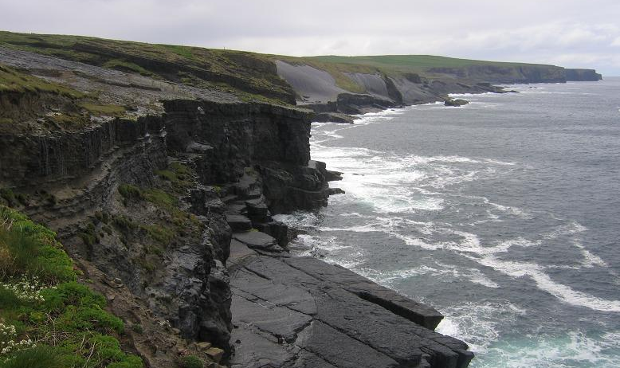

Slide 7
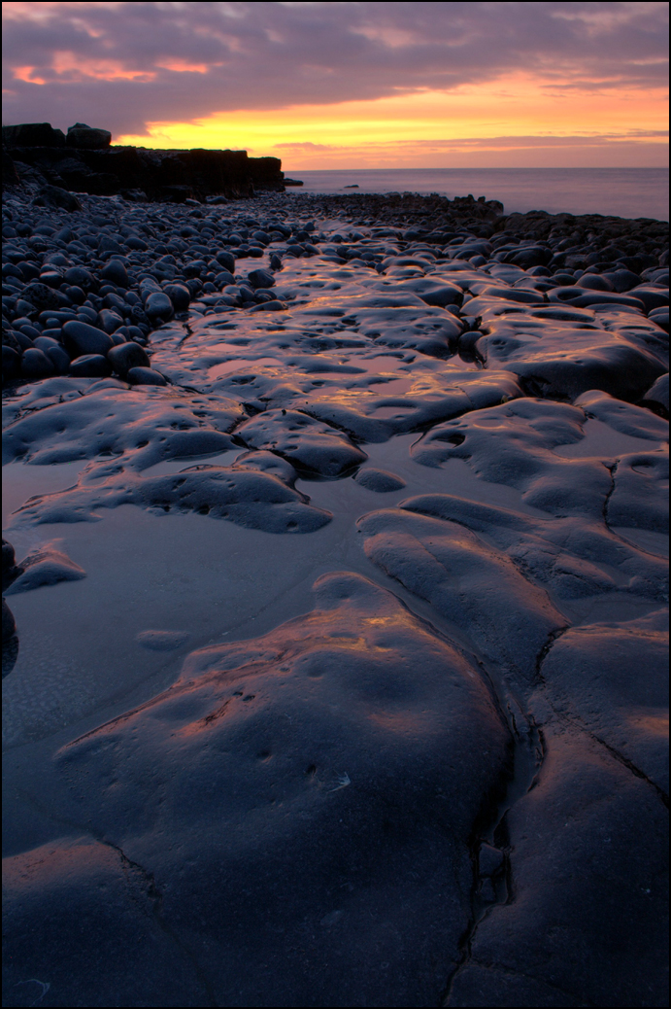

Slide 8
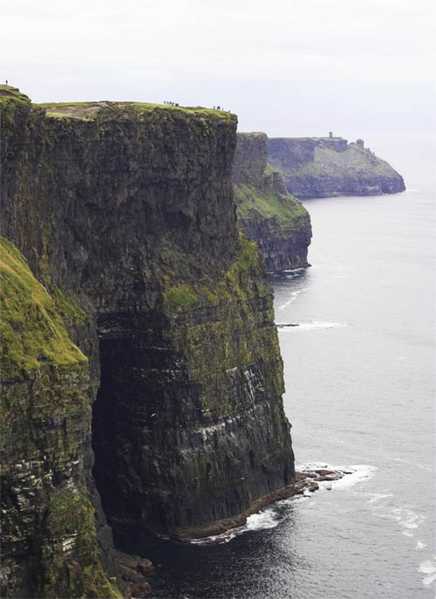

Slide 9
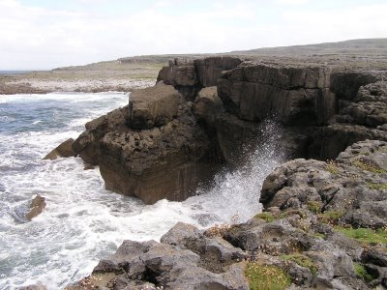

Slide 10
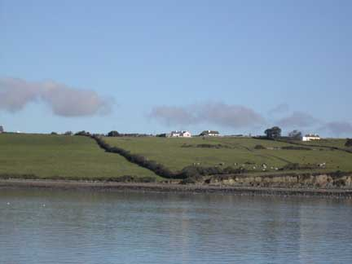

Slide 11
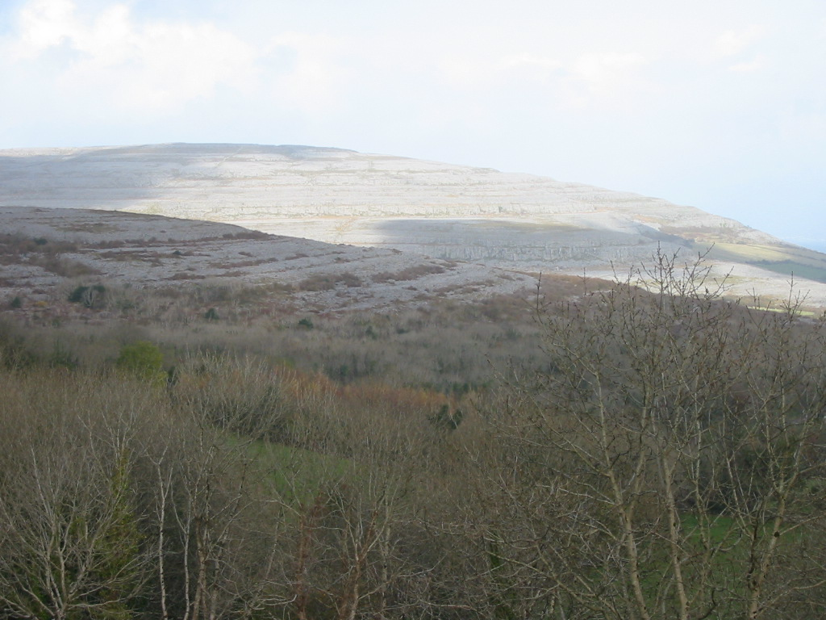

Slide 12
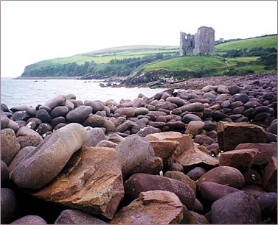

Slide 13
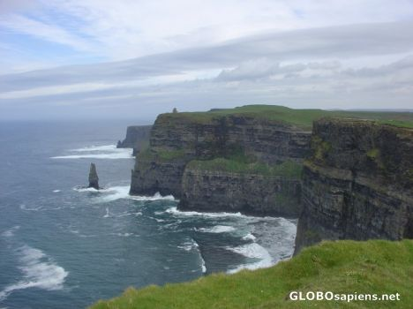

Slide 14
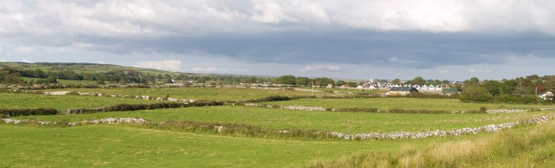

Slide 15
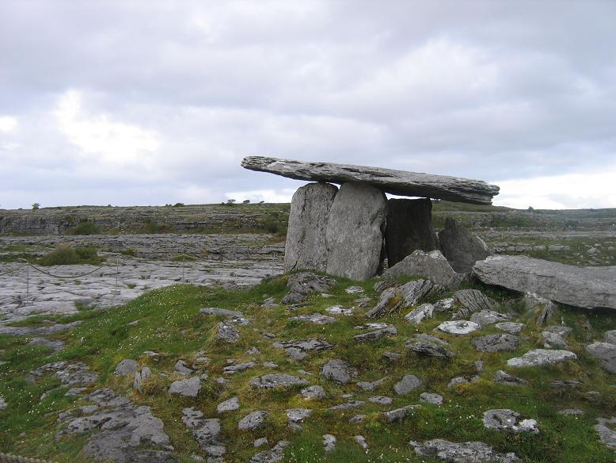

Slide 16
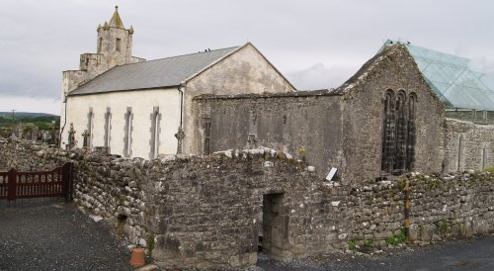

Slide 17
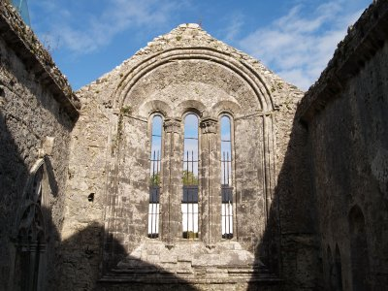

Slide 18
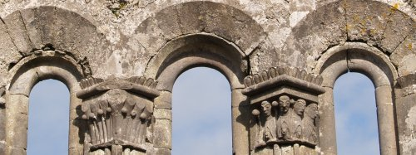

Slide 19
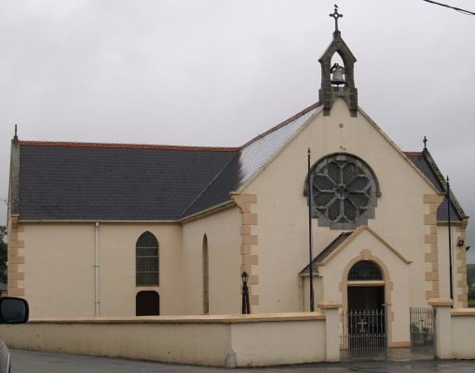

Slide 20
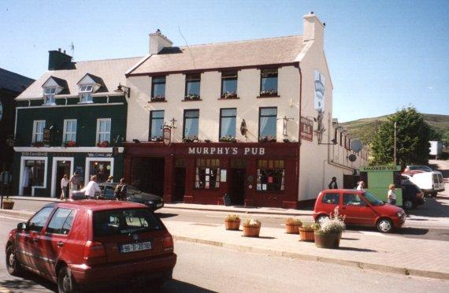

Slide 21
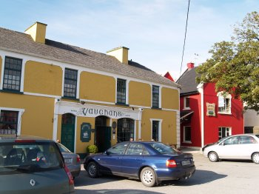

Slide 22


Slide 23
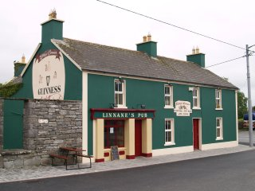

Slide 24


Slide 25
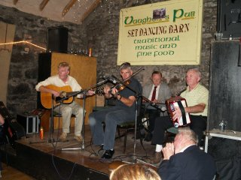

Slide 26
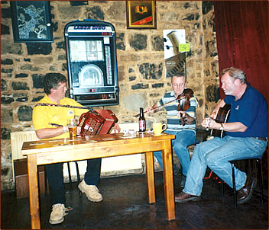

Slide 27
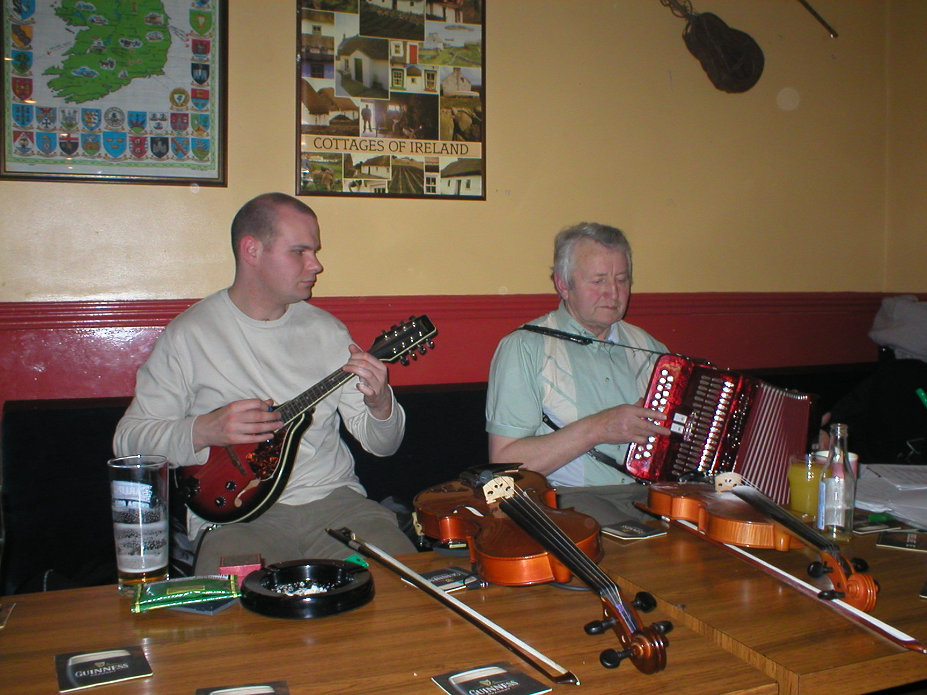

Slide 28
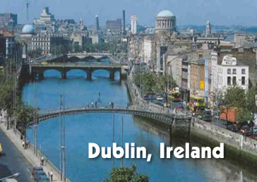

Slide 29
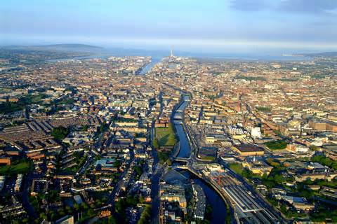

Slide 30
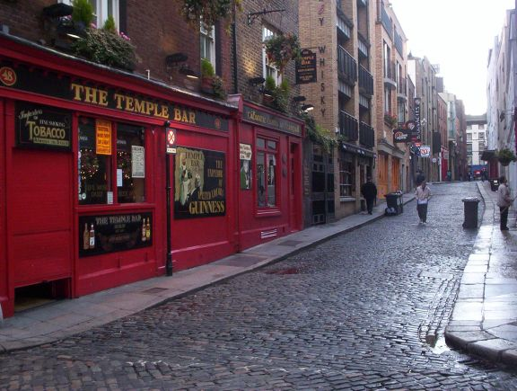

Slide 31


Slide 32
